Slide 1
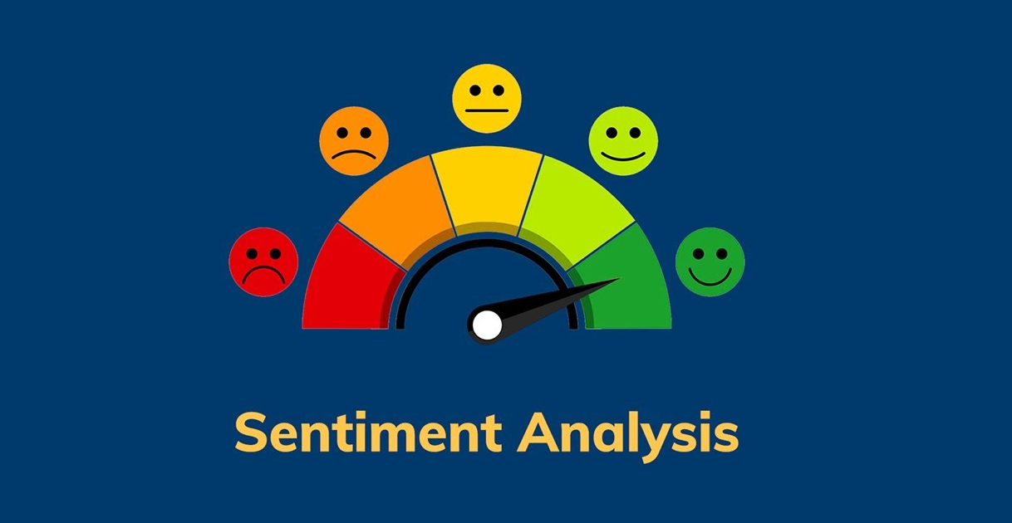

Slide 2
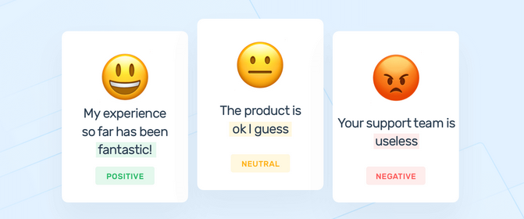
What is Sentiment Analysis?
Sentiment analysis (or opinion mining) is a natural language processing (NLP) technique used to determine whether data is positive, negative or neutral. Sentiment analysis is often performed on textual data to help businesses monitor brand and product sentiment in customer feedback and understand customer needs.
Notes:
Sentiment Analysis : Sentiment analysis is a popular task in natural language processing. The goal of sentiment analysis is to classify the text based on the mood or mentality expressed in the text, which can be positive negative, or neutral.
It is the process of classifying whether a block of text is positive, negative, or neutral. The goal that Sentiment mining tries to gain is to be analysed people’s opinions in a way that can help businesses expand. It focuses not only on polarity (positive, negative & neutral) but also on emotions (happy, sad, angry, etc.). It uses various NLP algorithms such as Rule-based, Automatic, and Hybrid.

Slide 3
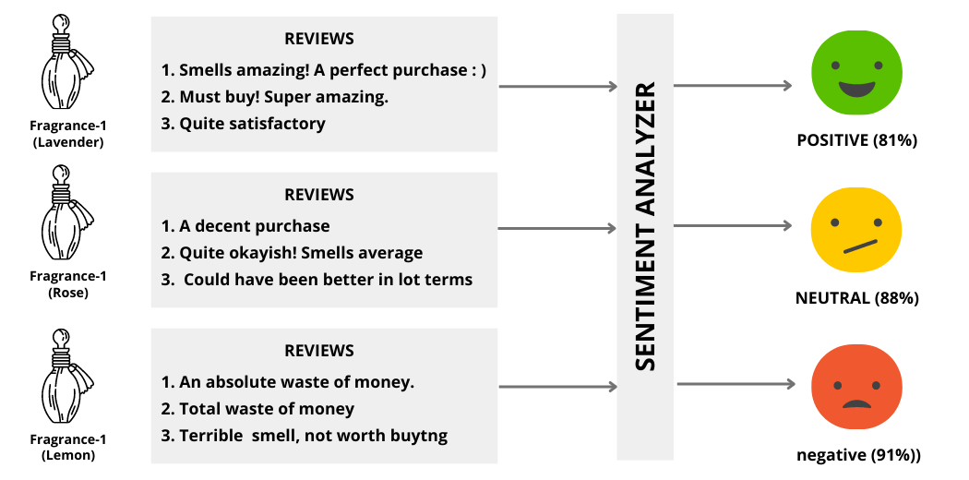
Notes:
Sentiment Analyzer example for different reviews and classified as Negative, Neutral and Positive.

Slide 4
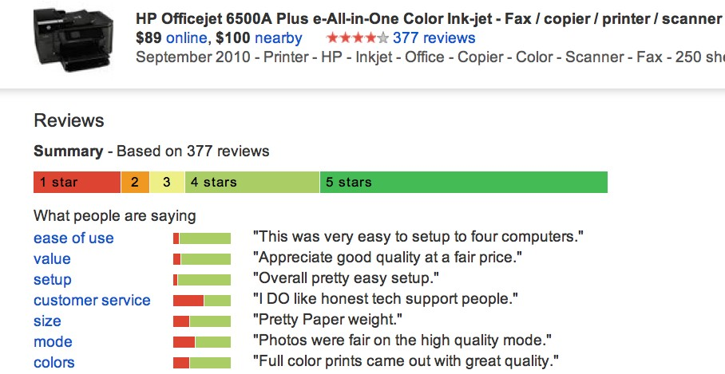
Google Product Search
a
4
Notes:
Example for Sentiment Analysis of a product and its reviews

Slide 5
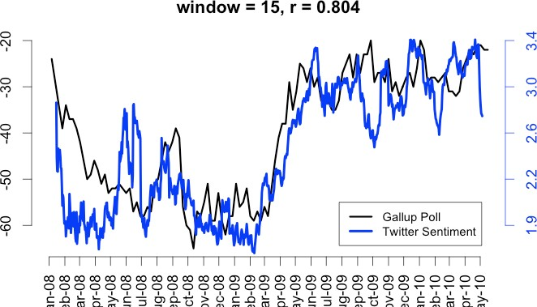
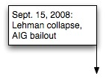
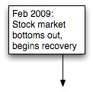
Twitter sentiment versus Gallup Poll of Consumer Conﬁdence
Brendan O'Connor, Ramnath Balasubramanyan, Bryan R. Routledge, and Noah A. Smith. 2010.
From Tweets to Polls: Linking Text Sentiment to Public Opinion Time Series. In ICWSM-­‐2010

Slide 6
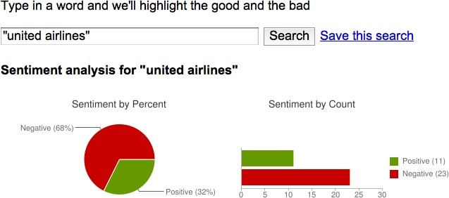
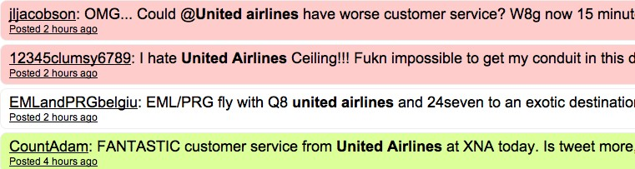
Target Sentiment on Twitter
Twitter Sentiment App
Alec Go, Richa Bhayani, Lei Huang. 2009. Twitter Sentiment Classification using Distant Supervision

Slide 7
Opinion extraction
Opinion mining
Sentiment mining
Subjectivity analysis
Sentiment analysis is also referred as
Notes:
Sentiment analysis, also known as opinion mining, Opinion extraction, Sentiment mining, Subjectivity analysis

Slide 8

Why sentiment analysis?
Movie: is this review positive or negative?
Products: what do people think about the new iPhone?
Public sentiment: how is consumer confidence? Is despair increasing?
Politics: what do people think about this candidate or issue?
Prediction: predict election outcomes or market trends from sentiment
Notes:
Sentiment analysis is the contextual meaning of words that indicates the social sentiment of a brand and also helps the business to determine whether the product they are manufacturing is going to make a demand in the market or not.
According to the survey,80% of the world’s data is unstructured. The data needs to be analyzed and be in a structured manner whether it is in the form of emails, texts, documents, articles, and many more.
Sentiment Analysis is required as it stores data in an efficient, cost friendly.
Sentiment analysis solves real-time issues and can help you solve all real-time scenarios.

Slide 9
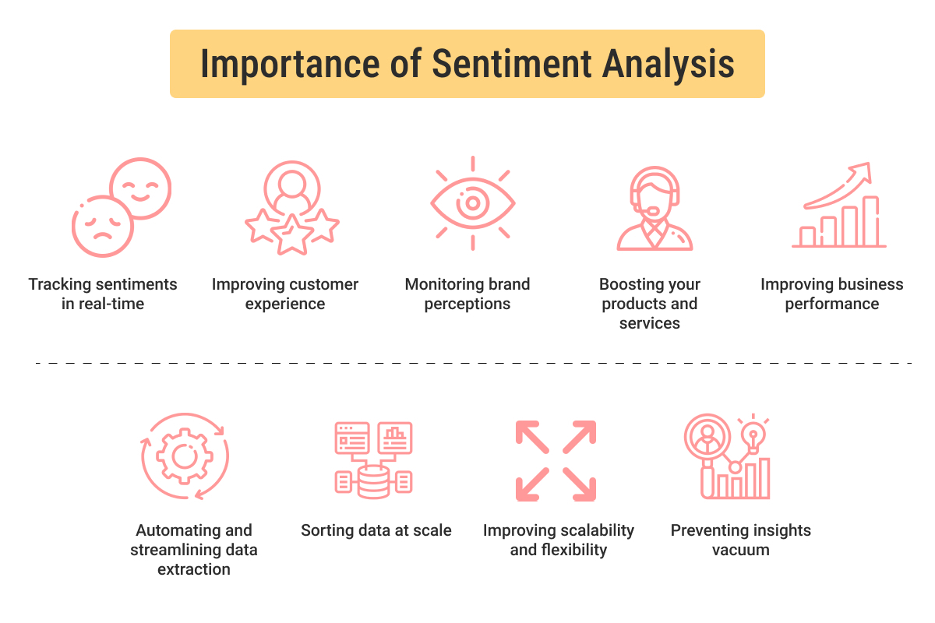
Notes:
why sentiment analysis is important?
Customer Feedback Analysis: Businesses can analyze customer reviews, comments, and feedback to understand the sentiment behind them helping in identifying areas for improvement and addressing customer concerns, ultimately enhancing customer satisfaction. Brand Reputation Management: Sentiment analysis allows businesses to monitor their brand reputation in real-time. By tracking mentions and sentiments on social media, review platforms, and other online channels, companies can respond promptly to both positive and negative sentiments, mitigating potential damage to their brand. Product Development and Innovation: Understanding customer sentiment helps identify features and aspects of their products or services that are well-received or need improvement.
Competitor Analysis: Sentiment Analysis can be used to compare the sentiment around a company’s products or services with those of competitors. Marketing Campaign Effectiveness: Businesses can evaluate the success of their marketing campaigns by analyzing the sentiment of online discussions and social media mentions.

Slide 10
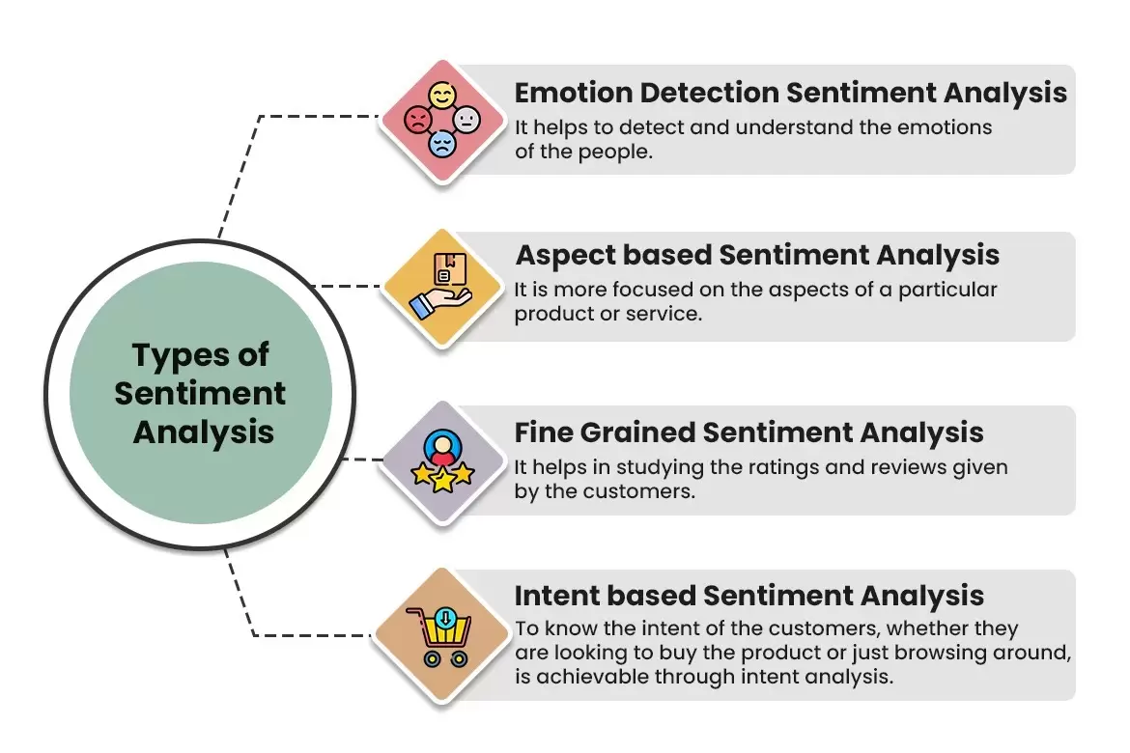
Notes:
Types of Sentiment Analysis

Slide 11
Scherer Typology of Aﬀective States
Emotion: brief organically synchronized … evaluation of a major event
angry, sad, joyful, fearful, ashamed, proud, elated
Mood: diﬀuse non-­‐caused low-­‐intensity long-­‐duration change in subjective feeling
cheerful, gloomy, irritable, listless, depressed, buoyant
Interpersonal stances: aﬀective stance toward another person in a specific interaction
friendly, ﬂirtatious, distant, cold, warm, supportive, contemptuous
Attitudes: enduring, aﬀectively colored beliefs, dispositions towards objects or persons
liking, loving, hating, valuing, desiring
Personality traits: stable personality dispositions and typical behavior tendencies
nervous, anxious, reckless, morose, hostile, jealous
Notes:
The depiction of the Scherer Typology of Affective States. This typology classifies affective states, or emotional experiences, into five categories

Slide 12
Sentiment Analysis
Sentiment analysis is the detection of attitudes
“enduring, aﬀectively colored beliefs, dispositions towards objects or persons”
Holder (source) of attitude
Target (aspect) of attitude
Type of attitude
From a set of types
Like, love, hate, value, desire, etc.
Or (more commonly) simple weighted polarity:
positive, negative, neutral, together with strength
Text containing the attitude
Sentence or entire document
Notes:
the key parts of sentiment analysis
Holder (source) of attitude:This refers to the person or entity expressing the sentiment. Target (aspect) of attitude: This refers to what the sentiment is directed towards. Type of attitude: This is the emotional category of the sentiment. The text mentions basic categories like like, love, hate, value, and desire. Text containing the attitude: This is the part of the text that expresses the sentiment. It can be a sentence or an entire document.

Slide 13
Sentiment Analysis
Simplest task:
Is the attitude of this text positive or negative?
More complex:
Rank the attitude of this text from 1 to 5
Advanced:
Detect the target, source, or complex attitude types
Notes:
Different levels of Sentiment Analysis tasks

Slide 14
IMDB data in the Pang and Lee database
✗
“ snake eyes ” is the most aggravating kind of movie : the kind that shows so much potential then becomes unbelievably disappointing .
it’s not just because this is a brian depalma film , and since he’s a great director and one who’s films are always greeted with at least some fanfare .
and it’s not even because this was a film starring nicolas cage and since he gives a brauvara performance , this film is hardly worth his talents .
✓
when _star wars_ came out some twenty years ago , the image of traveling throughout the stars has become a commonplace image . […]
when han solo goes light speed , the stars change to bright lines , going towards the viewer in lines that converge at an invisible point .
cool .
_october sky_ oﬀers a much simpler image–that of a single white dot , traveling horizontally across the night sky . [. . . ]
Notes:
Imdb example review to classify the sentiment

Slide 15
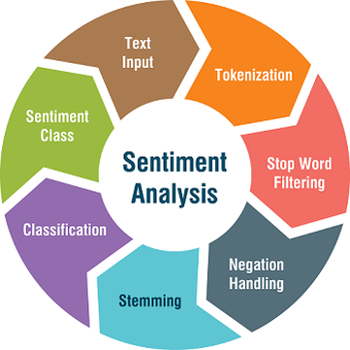
Workflow
Notes:
Text Input: This is the initial stage where the text data you want to analyze for sentiment is entered into the system.
Tokenization: The text is broken down into smaller units called tokens. These tokens can be individual words, punctuation marks, or even emojis.
Stop Word Filtering: Some words, like "the" or "and", don't carry much sentiment by themselves. These words, called stop words, are often filtered out at this stage.
Stemming (Optional): This step reduces words to their base form. For example, the words "running" and "runs" would both be stemmed to "run".
Sentiment Analysis: This is the core stage where the sentiment of each token or remaining phrase is determined. Techniques used here might involve:
Lexicon-based analysis: Matching words in the text against a predefined list (lexicon) of words with positive or negative connotations.
Machine learning models: These models are trained on large datasets of labeled text data to automatically identify sentiment.
Negation Handling: This step considers the impact of negation words like "not" or "no" on the overall sentiment of a phrase. For instance, "not good" would be considered negative even though "good" by itself is positive.
Sentiment Classification: Finally, based on the sentiment analysis of individual tokens or phrases, the text is classified into an overall sentiment category. This could be positive, negative, or neutral.

Slide 16
Baseline Algorithm (adapted from Pang and Lee)
Tokenization
Feature Extraction
Classification using diﬀerent classifiers
Naïve Bayes
MaxEnt
SVM
Notes:
In the work by Pang and Lee on sentiment analysis, a baseline algorithm refers to a simple but effective method used as a benchmark for evaluating more complex sentiment analysis techniques. Their approach focused on movie review sentiment classification.
Here's a breakdown of the Pang and Lee baseline algorithm:
Preprocessing
Sentiment Lexicon
Sentiment Score Calculation
Sentiment Classification Based on the total sentiment score, the review is classified as positive, negative, or neutral. A threshold is set around zero. Reviews with scores above the threshold are classified as positive, those below are negative, and those close to zero are neutral.

Slide 17
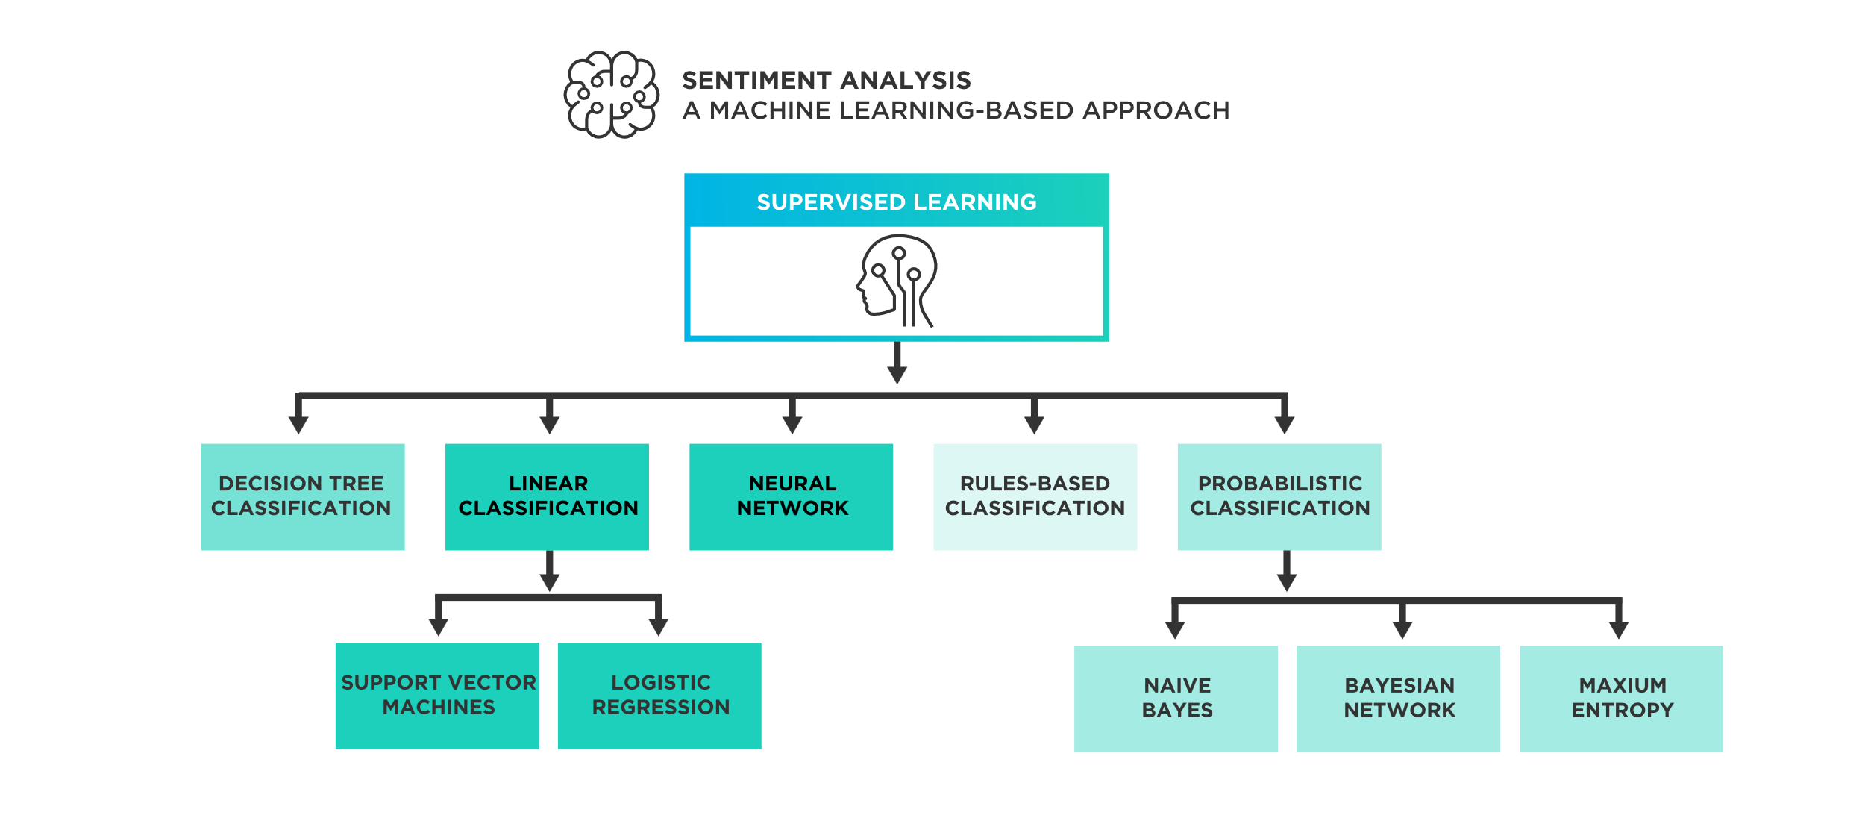
Notes:
Different classification methods to build a sentiment analysis model

Slide 18
Sentiment Tokenization Issues
Deal with HTML and XML markup
Twitter mark-­‐up (names, hash tags)
Capitalization (preserve for
Potts emoticons
words in all caps)
Phone numbers, dates
Emoticons
Useful code:
[<>]?
[:;=8]
[\-o\*\']?
[\)\]\(\[dDpP/\:\}\{@\|\\]
|
[\)\]\(\[dDpP/\:\}\{@\|\\] [\-o\*\']?
[:;=8]
[<>]?
# optional hat/brow # eyes
# optional nose
# mouth
#### reverse orientation
# mouth
# optional nose # eyes
# optional hat/brow
Christopher Potts sentiment tokenizer
Brendan O’Connor twitter tokenizer
Notes:
Sentiment analysis heavily relies on tokenization, which is the process of breaking down text data into smaller units for analysis. However, tokenization can introduce some challenges that can impact the accuracy of sentiment analysis:
Negation Handling: Negation words like "not" or "no" can flip the sentiment of a phrase. For example, "not good" is negative even though "good" by itself is positive. During tokenization, these negation words might get separated from the words they modify, making it difficult to capture the intended sentiment of the phrase.
Emojis and Emoticons:Emojis and emoticons can convey strong sentiment but might not be recognized as single units during basic tokenization.
Contractions: Contractions like "don't" or "can't" get broken down into separate tokens during tokenization.

Slide 19
Extracting Features for Sentiment Classiﬁcation
How to handle negation
I didn’t like this
vs
I really like this
Which words to use?
Only adjectives
All words
movie
movie
All words turns out to work better, at least on this data
Notes:
Feature extraction is a crucial step in sentiment analysis because it involves transforming the raw text data into a format suitable for machine learning models. These features capture essential characteristics of the text that are relevant to sentiment classification.

Slide 20

Negation
Das, Sanjiv and Mike Chen. 2001. Yahoo! for Amazon: Extracting market sentiment from stock message boards. In Proceedings of the Asia Pacific Finance Association Annual Conference (APFA). Bo Pang, Lillian Lee, and Shivakumar Vaithyanathan. 2002. Thumbs up? Sentiment Classification using Machine Learning Techniques. EMNLP-2002, 79—86.
Add NOT_ to every word between negation and following punctuation:
didn’t like this movie , but I
didn’t NOT_like NOT_this NOT_movie but I
Notes:
negation handling
Identifying Negation Words: The first step is to identify negation words like "not", "no", "never", "barely", etc. within the sentence. Locating the Scope of Negation: The next step is to determine the words or phrases affected by the negation. This is called the scope of negation. Negation Marking: Once the scope of negation is identified, all the words within that scope are marked with a special notation, like "NO Negation handling is an important step in sentiment analysis to ensure accurate sentiment classification, especially when dealing with human language where nuances like negation can significantly alter the intended meaning.

Slide 21
∏
Reminder: Naïve Bayes
c_{NB} = argmax P(c_{j} )
P(w_{i} | c_{j} )
c_{j}∈C
i∈ positions
_{Pˆ(w | c) =} count(w, c) +1
count(c) + V
Notes:
Naive Bayes is a popular and effective algorithm used in sentiment analysis due to its simplicity and efficiency.
Understanding Naive Bayes:
Probabilistic Model: Naive Bayes is a probabilistic classifier. It calculates the probability of a text belonging to a specific sentiment class (positive, negative, or neutral) based on the presence of certain words.

Slide 22
Binarized (Boolean feature) Multinomial Naïve Bayes
Intuition:
For sentiment (and probably for other text classification domains)
Word occurrence may matter more than word frequency
The occurrence of the word fantastic tells us a lot
The fact that it occurs 5 times may not tell us much more.
Boolean Multinomial Naïve Bayes
Clips all the word counts in each document at 1

Slide 23
Multinomial Naïve Bayes: Learning
From training corpus, extract Vocabulary
Calculate P(c_{j}) terms
For each c_{j} in C do
docs_{j} ← all docs with class =c_{j}
Calculate P(w_{k} | c_{j}) terms
Text_{j} ← single doc containing all docs_{j}
For each word w_{k} in Vocabulary
n_{k} ← # of occurrences of w_{k} in Text_{j}
Notes:
This code snippet calculates the essential word counts (njk and nj) needed to estimate the conditional probability P(xk | cj) for each word in the vocabulary and for each class during the training phase of the Naive Bayes classifier.

Slide 24
Boolean Multinomial Naïve Bayes on a test document d
First remove all duplicate words from d
Then compute NB using the same equation:
∏
c_{NB} = argmax P(c_{j} )
P(w_{i} | c_{j} )
c_{j}∈C
i∈ positions
Notes:
The main equation represents how the Naïve Bayes classifier makes a prediction. The predicted class c^NB​ is the one that maximizes the probability P(cj)P(cj​) times the product of the conditional probabilities P(wi∣cj)P(wi​∣cj​) for each word position ii in the document.
c^NBc^NB​ is the class predicted by Naïve Bayes.
argmax is the argument of the maximum, a mathematical function that finds the value that gives the maximum value of the function being considered.
P(cj)P(cj​) is the prior probability of class cj​.
∏ is the product symbol, indicating that you multiply the subsequent terms together.
P(wi∣cj)P(wi​∣cj​) is the conditional probability of word wiw given class cj.
ii iterates over the positions of words in the document.
C is the set of all classes.

Slide 25
Normal vs. Boolean Multinomial NB
Normal | Doc | Words | Class
Training | 1 | Chinese Beijing Chinese | c
 | 2 | Chinese Chinese Shanghai | c
 | 3 | Chinese Macao | c
 | 4 | Tokyo Japan Chinese | j
Test | 5 | Chinese Chinese Chinese Tokyo Japan | ?
Boolean | Doc | Words | Class
Training | 1 | Chinese Beijing | c
 | 2 | Chinese Shanghai | c
 | 3 | Chinese Macao | c
 | 4 | Tokyo Japan Chinese | j
Test | 5 | Chinese Tokyo Japan | ?
Notes:
Normal Representation:
In this approach, the frequency of words is considered in the document representation. This means if the word "Chinese" appears three times in a document, it is counted as three occurrences.
The first four documents are part of the training set, with given classes 'c' (probably for 'China') and 'j' (probably for 'Japan'). The fifth document is in the test set, and its class is what the NB classifier will predict.
Documents 1, 2, and 3 are classified as 'c', and Document 4 is classified as 'j’.
Boolean Representation:
This method accounts only for the presence or absence of a word in the document, regardless of its frequency. Hence, even if "Chinese" appears multiple times in a document, it is considered only once.
The training set structure is similar to the Normal representation, but with duplicate words removed. For example, in Document 1, "Chinese" is listed only once, despite appearing twice in the Normal representation.
The test document (Document 5) is to be classified using the Boolean Multinomial NB classifier based on the training data provided.

Slide 26
Binarized (Boolean feature) Multinomial Naïve Bayes
B. Pang, L. Lee, and S. Vaithyanathan. 2002. Thumbs up? Sentiment Classification using Machine Learning Techniques. EMNLP-­‐2002, 79—86.
V. Metsis, I. Androutsopoulos, G. Paliouras. 2006. Spam Filtering with Naive Bayes – Which Naive Bayes?
CEAS 2006 -­‐ Third Conference on Email and Anti-­‐Spam.
K.-­‐M. Schneider. 2004. On word frequency information and negative evidence in Naive Bayes text
classification. ICANLP, 474-­‐485.
JD Rennie, L Shih, J Teevan. 2003. Tackling the poor assumptions of naive bayes text classifiers. ICML 2003
Binary seems to work better than full word counts
This is not the same as Multivariate Bernoulli Naïve Bayes
MBNB doesn’t work well for sentiment or other text tasks
Other possibility: log(freq(w))
MaxEnt and SVM tend to do better than Naïve Bayes
Notes:
It is observed that binary representation (indicating the presence or absence of words) seems to be more effective than using full word counts (frequency of words) for certain NLP tasks.
The text clarifies that binary representation is not the same as MBNB. While MBNB is a form of Naïve Bayes classifier that also uses binary representation, it does so under different assumptions.
MaxEnt (Maximum Entropy) classifiers and Support Vector Machines (SVM) are mentioned as typically performing better than Naïve Bayes classifiers. MaxEnt is a probabilistic classifier, like Naïve Bayes, but without the independence assumptions, allowing it to capture more complex relationships between features.

Slide 27
Cross-­‐Validation
Iteration
Test
Training
Break up data into 10 folds
(Equal positive and negative inside each fold?)
For each fold
Choose the fold as a temporary test set
Train on 9 folds, compute performance on the test fold
Report average performance of the 10 runs
1
 | Test | Training
2
Training | Test | Training
3
Training | Test
4
Training
Test
5
Notes:
The image you sent depicts a 10-fold cross-validation process for evaluating a machine learning model's performance.
Benefits of 10-Fold Cross-Validation:
Reduced Overfitting: By training and testing on different folds, the model is less likely to overfit to the specific characteristics of the training data, leading to better performance on unseen data.
Robust Performance Estimation: Averaging the performance metrics across multiple folds provides a more reliable estimate of the model's generalizability compared to using a single split for training and testing.

Slide 28
Problems:
What makes reviews hard to classify?
Subtlety:
Perfume review in Perfumes: the Guide:
“If you are reading this because it is your darling fragrance, please wear it at home exclusively, and tape the windows shut.”
Dorothy Parker on Katherine Hepburn
“She runs the gamut of emotions from A to B”
32
Notes:
The slide points out a common problem in sentiment analysis: classifying reviews correctly can be challenging due to subtlety. Subtlety refers to the nuanced and often indirect ways people express their opinions or emotions in text.
These examples demonstrate how subtle linguistic devices like irony, sarcasm, and euphemism can complicate sentiment analysis. Standard approaches to sentiment classification often rely on the presence of explicitly positive or negative keywords and might miss the true sentiment behind sophisticated expressions like these. Understanding such subtleties requires advanced NLP techniques that can interpret context, tone, and sometimes even cultural references to accurately gauge sentiment.

Slide 29
Thwarted Expectations and Ordering Eﬀects
“This film should be brilliant. It sounds like a great plot, the actors are first grade, and the supporting cast is good as well, and Stallone is attempting to deliver a good performance. However, it can’t hold up.”
Well as usual Keanu Reeves is nothing special, but surprisingly, the very talented Laurence Fishbourne is not so good either, I was surprised.
33
Notes:
"Thwarted Expectations" and “ Ordering Effects" are concepts that can significantly influence the outcome of sentiment analysis, natural language processing, or psychological studies.
Thwarted Expectations:
This term refers to when an outcome does not align with what was anticipated or desired. In literature or customer reviews, for example, thwarted expectations might be expressed when a story does not follow the predicted plot line or a product does not meet the advertised quality.
Ordering Effects: Ordering effects relate to how the sequence or arrangement of content can influence a person's perception and interpretation.
Both concepts illustrate the complexity and subtlety involved in understanding human language and sentiment.

Slide 30
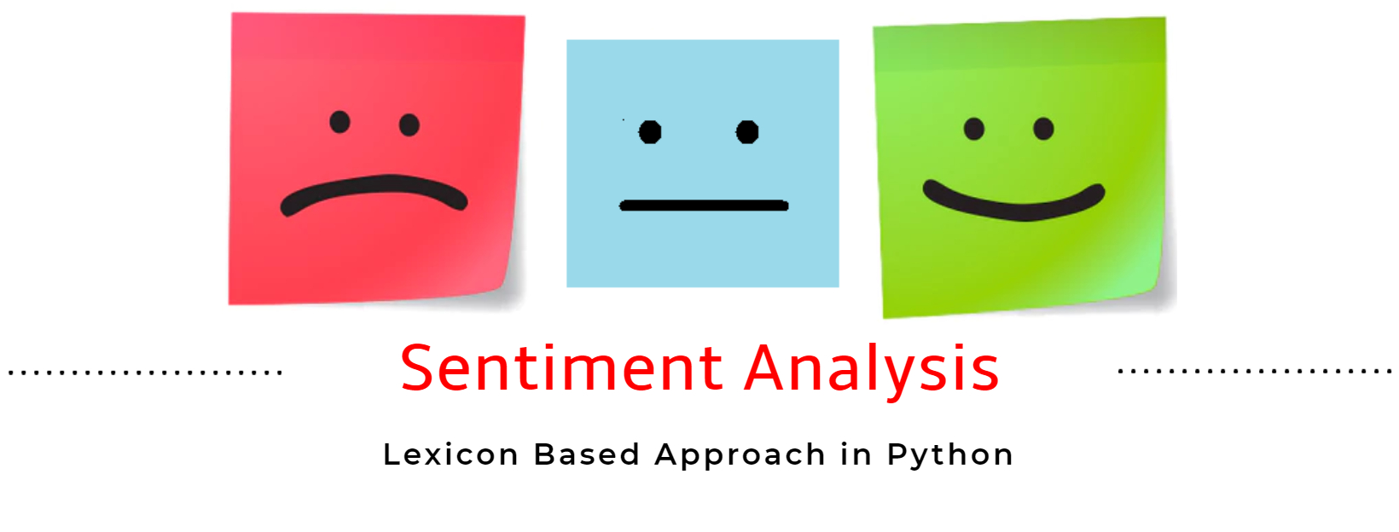
Notes:
Lexicon-based sentiment analysis is a fundamental approach used to determine the emotional tone of text data. It relies on pre-built dictionaries, also known as lexicons, that contain words and their associated sentiment scores.
lexicon-based sentiment analysis offers a good starting point for sentiment analysis tasks, especially for simple applications or when dealing with limited data. However, it's important to be aware of its limitations and consider more sophisticated techniques for complex sentiment analysis scenarios.

Slide 31
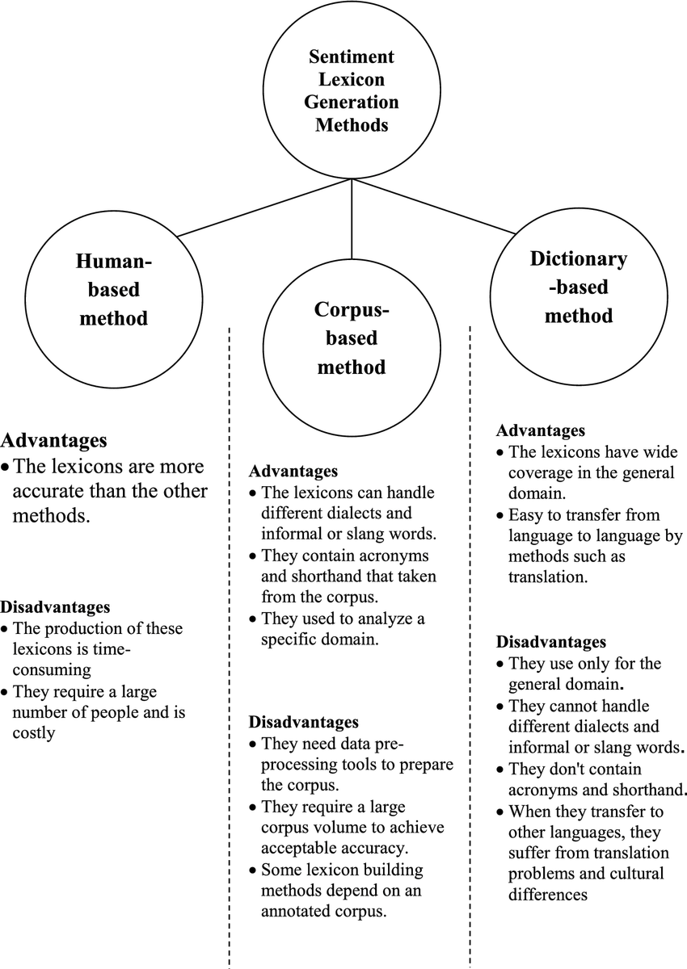
Notes:
Different Sentiment lexicon generation methods

Slide 32
The General Inquirer
Philip J. Stone, Dexter C Dunphy, Marshall S. Smith, Daniel M. Ogilvie. 1966. The General Inquirer: A Computer Approach to Content Analysis. MIT Press
Home page: http://www.wjh.harvard.edu/~inquirer
List of Categories: http://www.wjh.harvard.edu/~inquirer/homecat.htm
Spreadsheet: http://www.wjh.harvard.edu/~inquirer/inquirerbasic.xls
Categories:
Positiv (1915 words) and Negativ (2291 words)
Strong vs Weak, Active vs Passive, Overstated versus Understated
Pleasure, Pain, Virtue, Vice, Motivation, Cognitive Orientation, etc
Free for Research Use

Slide 33
LIWC (Linguistic Inquiry and Word Count)
Pennebaker, J.W., Booth, R.J., & Francis, M.E. (2007). Linguistic Inquiry and Word Count: LIWC 2007. Austin, TX
Home page: http://www.liwc.net/
2300 words, >70 classes
Aﬀective Processes
negative emotion (bad, weird, hate, problem, tough)
positive emotion (love, nice, sweet)
Cognitive Processes
Tentative (maybe, perhaps, guess), Inhibition (block, constraint)
Pronouns, Negation (no, never), Quantiﬁers (few, many)
$30 or $90 fee

Slide 34
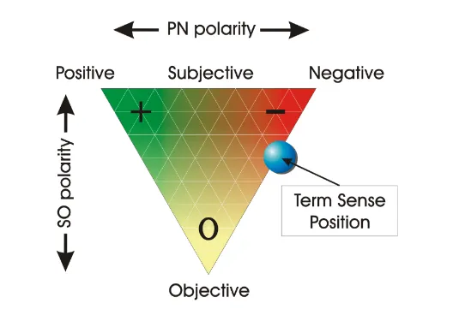
SentiWordNet:
SentiWordNet is a lexical resource for opinion mining. SentiWordNet assigns to each synset of WordNet three sentiment scores: positivity, negativity, objectivity.
Notes:
SentiWordNet is a lexical resource specifically designed to support sentiment analysis and opinion mining tasks. It builds upon an existing lexical database called WordNet, adding sentiment annotations to its existing word information.
WordNet is a large lexical database that groups English words into sets of synonyms called synsets. These synsets capture the different meanings a word can have depending on the context. SentiWordNet takes the synsets from WordNet and assigns sentiment scores to each word within a synset. These scores indicate the degree to which a word expresses positive, negative, or neutral sentiment.

Slide 35
SentiWordNet
Stefano Baccianella, Andrea Esuli, and Fabrizio Sebastiani. 2010 SENTIWORDNET 3.0: An Enhanced Lexical Resource for Sentiment Analysis and Opinion Mining. LREC-­‐2010
Home page: http://sentiwordnet.isti.cnr.it/
All WordNet synsets automatically annotated for degrees of positivity, negativity, and neutrality/objectiveness
[estimable(J,3)] “may be computed or estimated”
Pos 0 Neg 0 Obj 1
[estimable(J,1)] “deserving of respect or high regard”
Pos .75 Neg 0 Obj .25

Slide 36
Disagreements between polarity lexicons
Christopher Potts, Sentiment Tutorial, 2011
 | Opinion Lexicon | General Inquirer | SentiWordNet | LIWC
MPQA | 33/5402 (0.6%) | 49/2867 (2%) | 1127/4214 (27%) | 12/363 (3%)
Opinion Lexicon |  | 32/2411 (1%) | 1004/3994 (25%) | 9/403 (2%)
General Inquirer |  |  | 520/2306 (23%) | 1/204 (0.5%)
SentiWordNet |  |  |  | 174/694 (25%)
LIWC
Notes:
Disagreements between different polarity lexicons

Slide 37
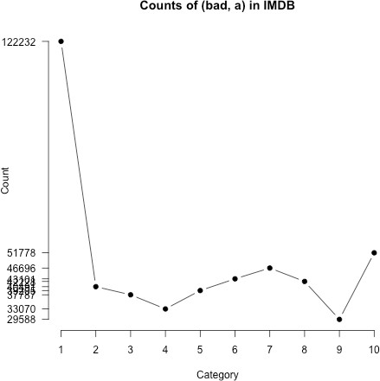
Analyzing the polarity of each word in IMDB
Potts, Christopher. 2011. On the negativity of negation. SALT 20, 636-­‐659.
How likely is each word to appear in each sentiment class?
Count(“bad”) in 1-­‐star, 2-­‐star, 3-­‐star, etc.
But can’t use raw counts:
Instead, likelihood:
f (w, c)
P(w | c) =
∑_{w∈c} f (w, c)
Make them comparable between words
Scaled likelihood:
P(w | c)
P(w)
Notes:
Objective: To determine how likely each word is to appear in reviews of each sentiment class. For example, it assesses the likelihood of the word "bad" appearing in 1-star, 2-star, and so on, up to 5-star reviews.
Issue with Raw Counts: Simply counting the word's occurrences (like "bad" in different star categories) is not enough
Likelihood: Instead of raw counts, the slide proposes using the likelihood. This is calculated as the frequency of the word "w" in a given class "c", denoted as f(w,c)f(w,c), divided by the sum of the frequencies of that word across all classes.
Scaled Likelihood: To make likelihood values comparable between words, a scaled likelihood is proposed. This scales the previously calculated likelihood by the overall probability of the word across the entire dataset

Slide 38
Analyzing the polarity of each word in IMDB
Potts, Christopher. 2011. On the negativity of negation. SALT 20, 636-­‐659.
POS good (883,417 tokens) amazing (103,509 tokens) great (648,110 tokens) awesome (47,142 tokens)
0.28
●
0.27
●
Scaled likelihood P(w|c)/P(w)
0.17
●
0.17
●
0.16
●
●
●
0.12
0.1
0.08
●
●
●
●
●
●
●
●
0.11
●
●
●
●
●
●
●
●
●
●
●
0.05
●
●
● ●
●
●
0.05
●
●
●
0.05
● ●
●
●
●
1 2 3 4 5 6 7 8 9 10
1 2 3 4 5 6 7 8 9 10
1 2 3 4 5 6 7 8 9 10
1 2 3 4 5 6 7 8 9 10
Rating
NEG good (20,447 tokens)
depress(ed/ing) (18,498 tokens)
bad (368,273 tokens)
terrible (55,492 tokens)
0.28
●
Scaled likelihood P(w|c)/P(w)
0.21
●
●
0.16
● ●
●
●
●
0.16
●
●
0.13
0.11
0.08
●
●
0.12
●
0.1
●
●
●
●
●
●
●
●
●
●
●
●
●
●
●
0.03
●
●
●
●
0.04
●
●
●
0.03
●
●
●
●
●
1 2 3 4 5 6 7 8 9 10
1 2 3 4 5 6 7 8 9 10
1 2 3 4 5 6 7 8 9 10
1 2 3 4 5 6 7 8 9 10
Notes:
Analyzing the polarity of each word like good, bad, amazing, terrible etc. in IMDB

Slide 39
Other sentiment feature: Logical negation
Potts, Christopher. 2011. On the negativity of negation. SALT 20, 636-­‐659.
Is logical negation (no, not) associated with negative sentiment?
Potts experiment:
Count negation (not, n’t, no, never) in online reviews
Regress against the review rating
Notes:
Logical negation words like "no," "not," "n't" (from contractions like "isn't" or "can't"), and "never" are often associated with negative sentiment because they are used to express denial, disagreement, or the absence of something. However, whether these negation words are always indicative of negative sentiment can be more complex than it seems at face value, as they can also be used in contexts that are neutral or even positive, such as "not bad" or "not a problem.“
Christopher Potts conducted an experiment to explore the association between negation words and sentiment by counting the occurrences of these negation terms in online reviews and then performing a regression analysis against the review ratings. The hypothesis would be that a higher frequency of negation words correlates with lower review ratings, suggesting that negation is associated with negative sentiment. The experiment's results would either support or challenge this hypothesis, contributing to our understanding of sentiment in text data.

Slide 40
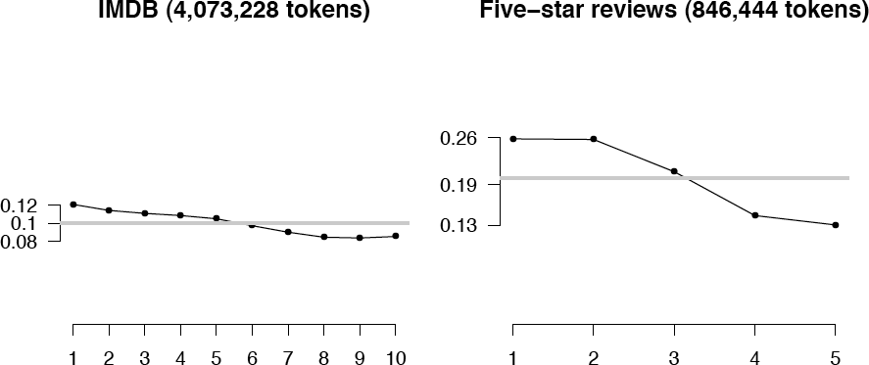
Potts 2011 Results:
More negation in negative sentiment
a
Scaled likelihood P(w|c)/P(w)

Slide 41
Semi-­‐supervised learning of lexicons
Use a small amount of information
A few labeled examples
A few hand-­‐built patterns
To bootstrap a lexicon
Notes:
The approach described here refers to a semi-supervised method for creating a sentiment lexicon called "bootstrapping." This method leverages a small set of labeled examples and hand-built patterns to iteratively create a larger lexicon of words associated with sentiment. Start with a Small Set of Labeled Examples: Begin with a small, carefully curated set of words labeled with their sentiment, such as "good" for positive or "bad" for negative.
Develop Hand-Built Patterns: Create patterns that typically convey sentiment. For instance, "X is a great example of" could be a pattern suggesting that X is positive, while "X suffers from" might indicate that X is negative. Apply Patterns to Unlabeled Data and Refine the Lexicon: Periodically review the lexicon to remove incorrect entries and adjust the sentiment values of entries based on their usage in context.

Slide 42
Hatzivassiloglou and McKeown intuition for identifying word polarity
Vasileios Hatzivassiloglou and Kathleen R. McKeown. 1997. Predicting the Semantic Orientation of Adjectives. ACL, 174–181
Adjectives conjoined by “and” have same polarity
Fair and legitimate, corrupt and brutal
*fair and brutal, *corrupt and legitimate
Adjectives conjoined by “but” do not
fair but brutal
Notes:
Conjunction with "and": If two adjectives are joined by the conjunction "and," it suggests that they have the same polarity. For example:
"Fair and legitimate" suggests that both adjectives are positive.
"Corrupt and brutal" implies that both adjectives are negative.
The use of * before "fair and brutal" and "corrupt and legitimate" indicates that these pairs are unlikely or incorrect because they would mix opposite polarities, which is generally not the case in natural language.
Conjunction with "but": When adjectives are connected by "but," it often indicates a contrast, suggesting that the adjectives have different polarities. For instance:
"Fair but brutal" would imply that "fair" is positive and "brutal" is negative.

Slide 43
Hatzivassiloglou & McKeown 1997 Step 1
Label seed set of 1336 adjectives (all >20 in 21 million word WSJ corpus)
657 positive
adequate central clever famous intelligent remarkable reputed sensitive slender thriving…
679 negative
contagious drunken ignorant lanky listless primitive strident troublesome unresolved unsuspecting…

Slide 44
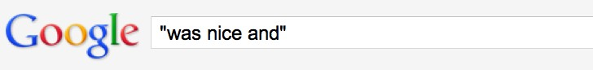
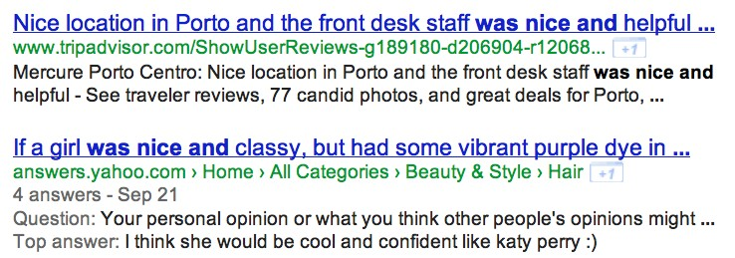
Hatzivassiloglou & McKeown 1997 Step 2
Expand seed set to conjoined adjectives
nice, helpful
nice, classy

Slide 45
Hatzivassiloglou & McKeown 1997 Step 3
Supervised classifier assigns “polarity similarity” to each word pair, resulting in graph:
brutal
helpful
corrupt
irrational
nice
fair
classy
Notes:
In sentiment analysis, a supervised classifier can be used to determine the "polarity similarity" between pairs of words. This approach involves using labeled data to train a model that can predict the sentiment relationship between two words
Training Data Preparation: Gather a dataset of word pairs labeled with their sentiment relationship.
Classifier Training: Use the labeled dataset to train a supervised learning classifier
Feature Extraction: For each word pair, extract relevant features that could be indicative of their sentiment relationship.

Slide 46
Hatzivassiloglou & McKeown 1997 Step 4
Clustering for partitioning the graph into two
+
-­‐
brutal
helpful
corrupt
irrational
nice
fair
classy
Notes:
Classifier Prediction: Input the features of each word pair into the trained classifier to obtain a prediction of their polarity similarity. This prediction might be a continuous score indicating the degree of similarity, or a categorical label such as "similar" or "opposite". Graph Construction: With the polarity similarity scores for word pairs, construct a graph where each node represents a word and each edge represents the polarity similarity between two words. The weight of an edge could correspond to the similarity score—the higher the score, the stronger the connection (edge) between the nodes (words) in the graph. Analysis and Application: Use this graph to analyze the sentiment structure of the language or lexicon being studied.

Slide 47
Output polarity lexicon
Positive
bold decisive disturbing generous good honest important large mature patient peaceful positive proud sound stimulating straightforward strange talented vigorous witty…
Negative
ambiguous cautious cynical evasive harmful hypocritical inefficient insecure irrational irresponsible minor outspoken pleasant reckless risky selfish tedious unsupported vulnerable wasteful…
Notes:
The resulting graph can be a powerful tool in sentiment analysis, offering a visual and quantitative way to understand how words relate to each other in terms of sentiment. This, in turn, can help in tasks such as refining sentiment lexicons, improving sentiment classification algorithms, and gaining insights into the sentiment dynamics of language.

Slide 48
Turney Algorithm
Turney (2002): Thumbs Up or Thumbs Down? Semantic Orientation Applied to Unsupervised Classification of Reviews
Extract a phrasal lexicon from reviews
Learn polarity of each phrase
Rate a review by the average polarity of its phrases
Notes:
The Turney Algorithm is a sentiment analysis technique that gauges the sentiment of text by extracting key phrases from reviews, determining the sentiment polarity of each phrase, and then calculating the overall sentiment of the review based on the average polarity of these phrases. This phrase-level analysis allows for a nuanced understanding of sentiment, taking context into account to provide a more accurate measure of the text's sentiment orientation.

Slide 49
Extract two-­‐word phrases with adjectives
First Word | Second Word | Third Word (not extracted)
JJ | NN or NNS | anything
RB, RBR, RBS | JJ | Not NN nor NNS
JJ | JJ | Not NN or NNS
NN or NNS | JJ | Nor NN nor NNS
RB, RBR, or RBS | VB, VBD, VBN, VBG | anything
Notes:
The image seems to provide rules for extracting two-word phrases that include adjectives based on part-of-speech tags.
JJ: Adjective
NN: Singular Noun
NNS: Plural Noun
RB: Adverb
RBR: Comparative Adverb
RBS: Superlative Adverb
VB: Verb, base form
VBD: Verb, past tense
VBN: Verb, past participle
VBG: Verb, gerund or present participle

Slide 50
How to measure polarity of a phrase?
Positive phrases co-­‐occur more with “excellent”
Negative phrases co-­‐occur more with “poor”
But how to measure co-­‐occurrence?
Notes:
There are two main approaches to measuring phrase polarity:
Lexicon-based approach:
This method relies on sentiment lexicons, which are dictionaries that assign sentiment scores (positive, negative, or neutral) to words
Co-Occurrence Measurement:
Co-occurrence refers to how often words appear together within a specific context (phrase, sentence, or document).

Slide 51
Pointwise Mutual Information
Mutual information between 2 random variables X and Y
∑∑
x y
P(x,y)
² P(x)P(y)
I(X,Y ) =
P(x, y) log
Pointwise mutual information:
How much more do events x and y co-­‐occur than if they were independent?
PMI(X,Y ) = log ^{P(x,y)}
² P(x)P(y)
Notes:
Pointwise mutual information (PMI) is a measure of association used in information theory and statistics. In the context of natural language processing, PMI is used to determine the association between words or phrases, often for tasks like collocation identification, sentiment analysis, or understanding semantic similarity.
The PMI of two events, word XX and word YY, quantifies the discrepancy between the probability of their co-occurrence, if they were independent, and their actual probability of co-occurrence.

Slide 52
Pointwise Mutual Information
Pointwise mutual information:
How much more do events x and y co-­‐occur than if they were independent?
PMI(X,Y ) = log ^{P(x,y)}
² P(x)P(y)
PMI between two words:
How much more do two words co-­‐occur than if they were independent?
P(word₁,word₂ )
² P(word₁)P(word₂ )
PMI(word₁, word₂ ) = log
Notes:
Where:
P(X,Y)P(X,Y) is the joint probability that both XX and YY occur together.
P(X)P(X) and P(Y)P(Y) are the individual probabilities of XX and YY, respectively.
The logarithm is typically base 2, which interprets the PMI in bits
PMI is particularly useful in sentiment analysis for identifying words that have a strong association with positive or negative sentiments. For example, if the phrase "not good" frequently occurs in negative reviews, the PMI between "not" and "good" within the context of negative reviews would be high, helping to signal that this particular combination has a negative connotation.

Slide 53
How to Estimate Pointwise Mutual Information
Query search engine (Altavista)
P(word) estimated by
hits(word)/N
P(word₁,word₂) by
hits(word1 NEAR word2)/N²
hits(word₁ NEAR word₂ )
hits(word₁)hits(word₂ )
PMI(word₁, word₂ ) = log
2
Notes:
To estimate Pointwise Mutual Information (PMI) for two events, say XX and YY, you need to follow these steps:
Collect Data
Calculate Individual Probabilities
Calculate Joint Probability
Estimate PMI
By following these steps, you can estimate the PMI for word pairs in your dataset, which can then be used for various NLP tasks, including identifying collocations, understanding word similarities, or enhancing feature selection in machine learning models.

Slide 54
Does phrase appear more with “poor” or “excellent”?
Polarity( phrase) = PMI( phrase,"excellent") − PMI( phrase,"poor")
hits(phrase NEAR "excellent") _{− log} hits(phrase NEAR "poor")
= log
2
2
hits(phrase)hits("excellent") hits(phrase)hits("poor")
hits(phrase NEAR "excellent") hits(phrase)hits("poor") hits(phrase)hits("excellent") hits(phrase NEAR "poor")
= log
2
! hits(phrase NEAR "excellent")hits("poor") ⎞
= log
⎮ ⎮
2
⎛
hits(phrase NEAR "poor")hits("excellent")
⎠
Notes:
method for calculating the polarity of a phrase based on its association with the words "poor" and "excellent" using Pointwise Mutual Information (PMI). The PMI is a measure of association that compares the probability of observing two events together (the co-occurrence) with the probabilities of observing each event independently. This method allows one to determine whether a phrase tends to appear in a context that is more positive or negative by examining its proximity to positively or negatively connoted words. It’s a quantitative approach that can be particularly useful for sentiment analysis in large text corpora

Slide 55
Phrases from a thumbs-­‐up review
Phrase | POS tags | Polarity
online service | JJ NN | 2.8
online experience | JJ NN | 2.3
direct deposit | JJ NN | 1.3
local branch | JJ NN | 0.42
…
low fees | JJ NNS | 0.33
true service | JJ NN | -0.73
other bank | JJ NN | -0.85
inconveniently located | JJ NN | -1.5
Average |  | 0.32

Slide 56
Phrases from a thumbs-­‐down review
Phrase | POS tags | Polarity
direct deposits | JJ NNS | 5.8
online web | JJ NN | 1.9
very handy | RB JJ | 1.4
…
virtual monopoly | JJ NN | -2.0
lesser evil | RBR JJ | -2.3
other problems | JJ NNS | -2.8
low funds | JJ NNS | -6.8
unethical practices | JJ NNS | -8.5
Average |  | -1.2

Slide 57
Results of Turney algorithm
410 reviews from Epinions
170 (41%) negative
240 (59%) positive
Majority class baseline: 59%
Turney algorithm: 74%
Phrases rather than words
Learns domain-­‐specific information

Slide 58
Using WordNet to learn polarity
S.M. Kim and E. Hovy. 2004. Determining the sentiment of opinions. COLING 2004
M. Hu and B. Liu. Mining and summarizing customer reviews. In Proceedings of KDD, 2004
WordNet: online thesaurus (covered in later lecture).
Create positive (“good”) and negative seed-­‐words (“terrible”)
Find Synonyms and Antonyms
Positive Set: Add synonyms of positive words (“well”) and antonyms of negative words
Negative Set: Add synonyms of negative words (“awful”) and antonyms of positive words (”evil”)
Repeat, following chains of synonyms
• Filter
Notes:
WordNet, a rich lexical resource, can be employed to learn the sentiment polarity of words by using its network of synonyms, antonyms, and other semantic relationships. Starting with a seed list of words with known polarities, you can expand this list by identifying synonyms and antonyms in WordNet to infer similar or opposite sentiments, respectively. This method allows for the development of a nuanced sentiment lexicon, but it requires careful review and can be enhanced by integrating additional sentiment analysis tools like SentiWordNet.

Slide 59
Summary on Learning Lexicons
Advantages:
Can be domain-­‐specific
Can be more robust (more words)
Intuition
Start with a seed set of words (‘good’, ‘poor’)
Find other words that have similar polarity:
Using “and” and “but”
Using words that occur nearby in the same document
Using WordNet synonyms and antonyms
Notes:
Domain-Specific: By selecting a seed set of words pertinent to the particular domain of interest (like finance, healthcare, etc.), the resulting sentiment lexicon is tailored to the specific context, making it more accurate for that domain.
Robustness: As more words are discovered and added to the lexicon through various methods, the sentiment analysis can handle a wider range of expressions and vocabularies, increasing its robustness.
Intuition-Based Expansion:
Using "and" and "but": Identifies words with similar or contrasting polarity by how they are conjoined in sentences, relying on the linguistic intuition that words conjoined by "and" typically share polarity, whereas those connected by "but" usually do not.

Slide 60
Finding aspect/attribute/target of sentiment
M. Hu and B. Liu. 2004. Mining and summarizing customer reviews. In Proceedings of KDD.
S. Blair-­‐Goldensohn, K. Hannan, R. McDonald, T. Neylon, G. Reis, and J. Reynar. 2008. Building a Sentiment Summarizer for Local Service Reviews. WWW Workshop.
Frequent phrases + rules
Find all highly frequent phrases across reviews (“fish tacos”)
Filter by rules like “occurs right after sentiment word”
“…great fish tacos” means fish tacos a likely aspect
Casino | casino, buﬀet, pool, resort, beds
Children’s Barber | haircut, job, experience, kids
Greek Restaurant | food, wine, service, appetizer, lamb
Department Store | selection, department, sales, shop, clothing
Notes:
Finding the aspect, attribute, or target of sentiment within a text is a crucial task in sentiment analysis, often referred to as aspect-based sentiment analysis (ABSA). This task involves not only determining the sentiment expressed (positive, negative, neutral) but also identifying the specific aspect or feature that the sentiment is directed towards.
Aspect Extraction:Noun/Noun Phrase Identification: Aspects are often nouns or noun phrases that represent features of a product or topic of discussion. Techniques like part-of-speech tagging and noun phrase chunking can be used to extract potential aspects.
Dependency Parsing: Analyzing the syntactic structure of sentences to identify nouns that have dependency relations with opinion words.

Slide 61
Finding aspect/attribute/target of sentiment
The aspect name may not be in the sentence
For restaurants/hotels, aspects are well-­‐understood
Supervised classification
Hand-­‐label a small corpus of restaurant review sentences with aspect
food, décor, service, value, NONE
Train a classifier to assign an aspect to asentence
“Given this sentence, is the aspect food, décor, service, value, or NONE”
Notes:
Contextual Understanding:Recognizing that the sentiment toward an aspect may depend on the context, employing techniques such as sentiment modifiers (e.g., negation handling) and semantic role labeling.
Association of Sentiment with Aspects:Rule-Based Methods: Use rules to link sentiment words with the closest aspect in a sentence, often relying on syntactic patterns.
Co-Occurrence Analysis: Look for patterns in which certain sentiments appear frequently with certain aspects across the dataset.
Machine Learning Models: Supervised models can learn from labeled data to predict which aspects are associated with which sentiment expressions.

Slide 62
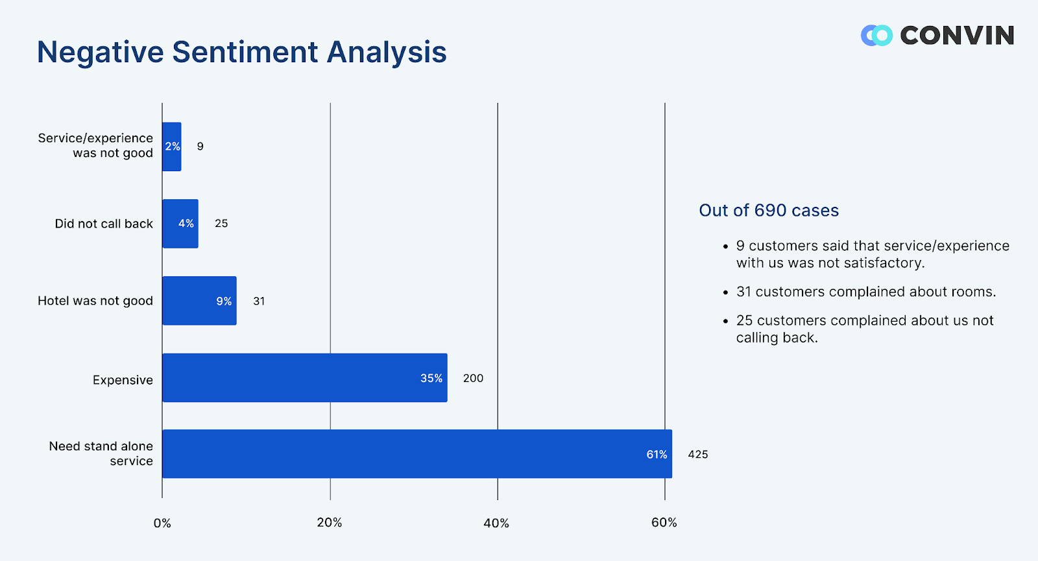

Slide 63
Putting it all together: Finding sentiment for aspects
S. Blair-­‐Goldensohn, K. Hannan, R. McDonald, T. Neylon, G. Reis, and J. Reynar. 2008. Building a Sentiment Summarizer for Local Service Reviews. WWW Workshop
Sentences & Phrases
Sentences & Phrases
Sentences & Phrases
Final Summary
Reviews
Text Extractor
Sentiment Classifier
Aspect Extractor
Aggregator
Notes:
Workflow to find sentiment for aspects

Slide 64
Results of Blair-­‐Goldensohn et al. method
Rooms (3/5 stars, 41 comments)
(+) The room was clean and everything worked fine – even the water pressure ...
(+) We went because of the free room and was pleasantly pleased ...
(-­‐) …the worst hotel I had ever stayed at ...
Service (3/5 stars, 31 comments)
(+) Upon checking out another couple was checking early due to a problem ...
(+) Every single hotel staﬀ member treated us great and answered every ...
(-­‐) The food is cold and the service gives new meaning to SLOW.
Dining (3/5 stars, 18 comments)
(+) our favorite place to stay in biloxi.the food is great also the service ...
(+) Oﬀer of free buﬀet for joining the Play
Notes:
Example results for reviews on hotels

Slide 65
Baseline methods assume classes have equal frequencies!
If not balanced (common in the real world)
can’t use accuracies as an evaluation
need to use F-­‐scores
Severe imbalancing also can degrade classifier performance
Two common solutions:
Resampling in training
Random undersampling
Cost-­‐sensitive learning
Penalize SVM more for misclassification of the rare thing
Notes:
Evaluation Challenges:
Unreliable Accuracies: When classes are imbalanced, accuracy (the proportion of true results among the total number of cases) is not a reliable metric. For example, if 95% of the data belongs to one class, a naive classifier that always predicts this majority class will achieve 95% accuracy, which does not reflect its true predictive power.
Classifier Performance Degradation:
Classifiers trained on imbalanced datasets may not perform well, as they tend to be biased toward the majority class and may not correctly identify instances of the minority class.
Random Undersampling: Reducing the size of the majority class by randomly removing instances until the classes are balanced. This can lead to loss of potentially important data.
Cost-Sensitive Learning:Instead of resampling, this method incorporates the costs of misclassification directly into the learning process. In the case of SVM (Support Vector Machine), this could mean assigning a higher penalty to misclassifications of the minority class.

Slide 66
How to deal with 7 stars?
Bo Pang and Lillian Lee. 2005. Seeing stars: Exploiting class relationships for sentiment categorization with respect to rating scales. ACL, 115–124
Map to binary
Use linear or ordinal regression
Or specialized models like metric labeling

Slide 67
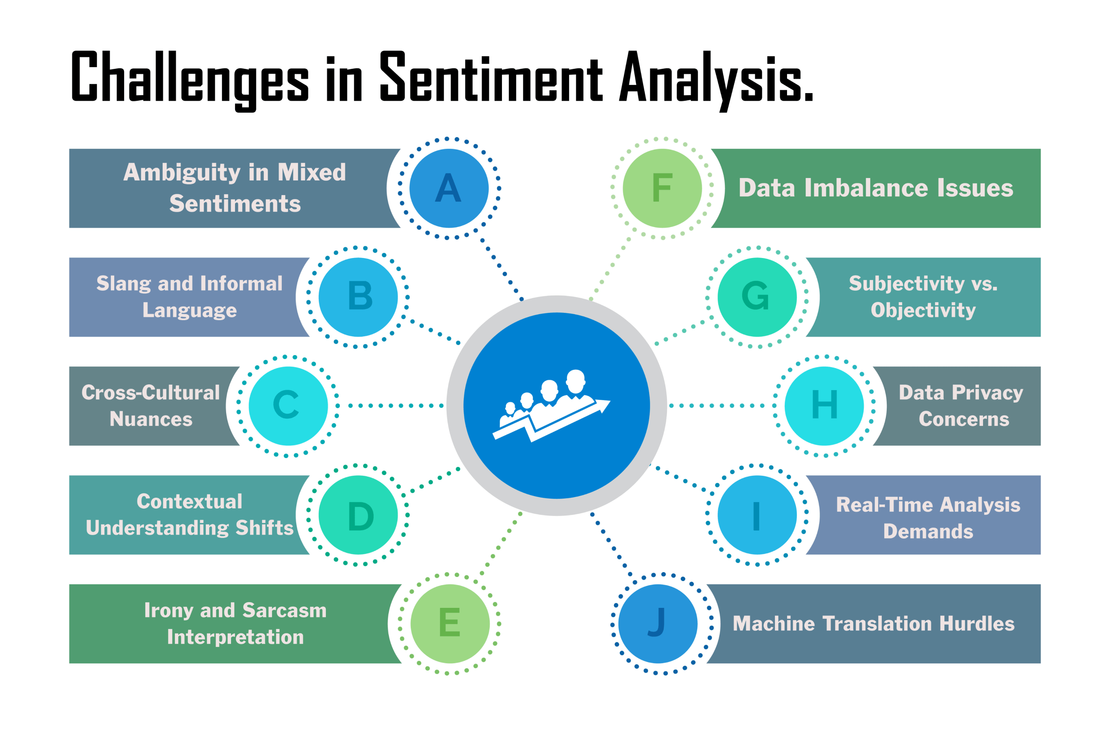
Notes:
Different challenges in sentiment analysis

Slide 68
Summary on Sentiment
Generally modeled as classification or regression task
predict a binary or ordinal label
Features:
Negation is important
Using all words (in naïve bayes) works well for some tasks
Finding subsets of words may help in other tasks
Hand-­‐built polarity lexicons
Use seeds and semi-­‐supervised learning to induce lexicons
Notes:
Sentiment analysis is typically approached as either a classification or a regression task:
Classification: Assigns a discrete label, such as positive, negative, or neutral sentiment to text.
Regression: Predicts a continuous or ordinal sentiment label, indicating the degree or intensity of sentiment.
Features and strategies crucial for these tasks include:
Negation: Words like "not" can completely reverse the sentiment of a phrase. Recognizing negation is crucial for accurate sentiment analysis.
In both classification and regression, the goal is to accurately predict sentiment, but the approach can vary significantly based on the task's specific requirements and the nature of the data.

Slide 69
Computational work on other aﬀective states
Emotion:
Detecting annoyed callers to dialogue system
Detecting confused/frustrated versus confident students
Mood:
Finding traumatized or depressed writers
Interpersonal stances:
Detection of ﬂirtation or friendliness in conversations
Personality traits:
Detection of extroverts
Notes:
The text describes the broader scope of computational work in affective computing beyond basic sentiment analysis.
Emotion Detection: This involves recognizing specific emotions, like annoyance or frustration, from text or speech. Mood Analysis: Mood is a more persistent emotional state compared to the transient nature of emotions.Interpersonal Stances: This area focuses on the detection of subtler social and relational signals such as flirtation or friendliness within conversations.Personality Traits: Detecting personality traits involves recognizing consistent patterns in behavior and language use that signal traits like extroversion.

Slide 70
Detection of Friendliness
Ranganath, Jurafsky, McFarland
Friendly speakers use collaborative conversational style
Laughter
Less use of negative emotional words
More sympathy
That’s too
More agreement
I think so
Less hedges
kind of
bad I’m sorry to hear that
too
sort of a little …
Notes:
The provided text appears to outline key characteristics of friendly speech as identified in research by Ranganath, Jurafsky, and McFarland, focusing on how these features can be used for the computational detection of friendliness in conversation:
Expressions of Sympathy: Phrases that show understanding and compassion, such as "That's too bad" or "I'm sorry to hear that," are indicative of a friendly demeanor.
Signs of Agreement: Friendly conversation often includes expressions of agreement, like "I think so too," suggesting a willingness to share perspectives and validate the other person's viewpoints.
Fewer Hedges: Hedges are words or phrases used to soften statements, such as "kind of," "sort of," and "a little." The suggestion is that friendly speakers use these less, which could imply greater directness or confidence in communication.

